Slide 1
Control statements in Java

Slide 2
Java’s Selection statements:
if
if-else
nested-if
if-else-if
switch-case
jump – break, continue, return
These statements allow you to control the flow of your program’s execution based upon conditions known only during run time.

Slide 3
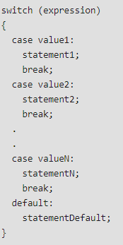
Switch case
The switch statement is a multiway branch statement. It provides an easy way to dispatch execution to different parts of code based on the value of the expression.

Slide 4
Switch
Note:
Expression can be of type byte, short, int char or an enumeration. Beginning with JDK7, expression can also be of type String.
Dulplicate case values are not allowed.
The default statement is optional.
The break statement is used inside the switch to terminate a statement sequence.
The break statement is optional. If omitted, execution will continue on into the next case.

Slide 5
Jump statements
Java supports three jump statement: break, continue and return. These three statements transfer control to other part of the program.Break: In Java, break is majorly used for:
Terminate a sequence in a switch statement (discussed above).
To exit a loop.
Used as a “civilized” form of goto.

Slide 6
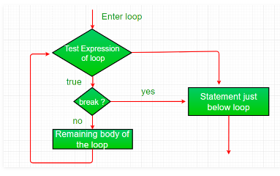
Using break to exit a Loop

Slide 7
Using break as a Form of Goto
Java does not have a goto statement because it provides a way to branch in an arbitrary and unstructured manner. Java uses label. A Label is use to identifies a block of code. Syntax:
label:
{ statement1; statement2; statement3; . . }

Slide 8
Continue
Sometimes it is useful to force an early iteration of a loop. That is, you might want to continue running the loop but stop processing the remainder of the code in its body for this particular iteration. This is, in effect, a goto just past the body of the loop, to the loop’s end. The continue statement performs such an action.

Slide 9
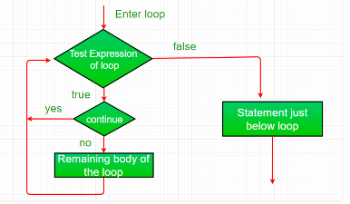

Slide 10
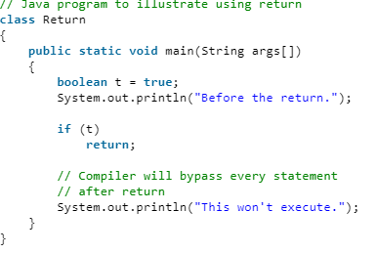
Return
he return statement is used to explicitly return from a method. That is, it causes a program control to transfer back to the caller of the method.

Slide 11
Arrays
An array is a group of like-typed variables that are referred to by a common name. Arrays in Java work differently than they do in C/C++. Following are some important point about Java arrays.
In Java all arrays are dynamically allocated.
Since arrays are objects in Java, we can find their length using member length. This is different from C/C++ where we find length using sizeof.
A Java array variable can also be declared like other variables with [] after the data type.
The variables in the array are ordered and each have an index beginning from 0.
Java array can be also be used as a static field, a local variable or a method parameter.
The size of an array must be specified by an int value and not long or short.
The direct superclass of an array type is Object.

Slide 12
Arrays
Array can contains primitives data types as well as objects of a class depending on the definition of array.
In case of primitives data types, the actual values are stored in contiguous memory locations.
In case of objects of a class, the actual objects are stored in heap segment.

Slide 13
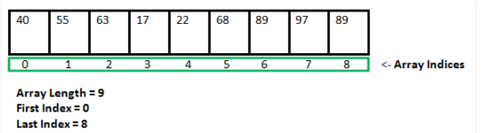
Advantages
Code Optimization: It makes the code optimized, we can retrieve or sort the data efficiently.
Random access: We can get any data located at an index position.
Disadvantages
Size Limit: We can store only the fixed size of elements in the array. It doesn't grow its size at runtime. To solve this problem, collection framework is used in Java which grows automatically.

Slide 14
Types of Arrays
There are two types of array.
Single Dimensional Array
Multidimensional Array

Slide 15
Single Dimensional Array in Java
Syntax to Declare an Array in Java
dataType[] arr; (or)
dataType []arr; (or)
dataType arr[];
Instantiation of an Array in Java
arrayRefVar=new datatype[size];

Slide 16
Instantiating an Array in Java
When an array is declared, only a reference of array is created. To actually create or give memory to array, you create an array like this:
The general form of new as it applies to one-dimensional arrays appears as follows:
var-name = new type [size];
Here, type specifies the type of data being allocated, size specifies the number of elements in the array, and var-name is the name of array variable that is linked to the array. That is, to use new to allocate an array, you must specify the type and number of elements to allocate.

Slide 17
int intArray[]; //declaring array
intArray = new int[20]; // allocating memory to array
OR
int[] intArray = new int[20]; // combining both statements in one

Slide 18
Note :
The elements in the array allocated by new will automatically be initialized to zero (for numeric types), false (for boolean), or null (for reference types).
Obtaining an array is a two-step process. First, you must declare a variable of the desired array type. Second, you must allocate the memory that will hold the array, using new, and assign it to the array variable. Thus, in Java all arrays are dynamically allocated.

Slide 19
Array Literal
In a situation, where the size of the array and variables of array are already known, array literals can be used.
int[] intArray = new int[]{ 1,2,3,4,5,6,7,8,9,10 };
// Declaring array literal
The length of this array determines the length of the created array.
There is no need to write the new int[] part in the latest versions of Java

Slide 20
Accessing Java Array Elements using for Loop
Each element in the array is accessed via its index. The index begins with 0 and ends at (total array size)-1. All the elements of array can be accessed using Java for Loop.
// accessing the elements of the specified array
for (int i = 0; i < arr.length; i++) System.out.println("Element at index " + i + " : "+ arr[i]);

Slide 21
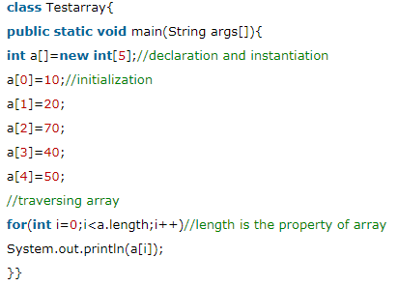
Declare, instantiate, initialize and traverse an array.

Slide 22
Declaration, Instantiation and Initialization of Java Array
We can declare, instantiate and initialize the java array together by:
int a[]={33,3,4,5};//declaration, instantiation
and initialization

Slide 23
ArrayIndexOutOfBoundsException
The Java Virtual Machine (JVM) throws an ArrayIndexOutOfBoundsException if length of the array in negative, equal to the array size or greater than the array size while traversing the array.
public class TestArrayException{
public static void main(String args[]){
int arr[]={50,60,70,80};
for(int i=0;i<=arr.length;i++){
System.out.println(arr[i]);
}
}}

Slide 24
Multidimensional Array in Java
In such case, data is stored in row and column based index (also known as matrix form).
Syntax to Declare Multidimensional Array in Java
dataType[][] arrayRefVar; (or)
dataType [][]arrayRefVar; (or)
dataType arrayRefVar[][]; (or)
dataType []arrayRefVar[];

Slide 25
int[][] arr=new int[3][3];//3 row and 3 column
arr[0][0]=1;
arr[0][1]=2;
arr[0][2]=3;
arr[1][0]=4;
arr[1][1]=5;
arr[1][2]=6;
arr[2][0]=7;
arr[2][1]=8;
arr[2][2]=9;

Slide 26
Example (2 D Array)
class Testarray3{
public static void main(String args[]){
//declaring and initializing 2D array
int arr[][]={{1,2,3},{2,4,5},{4,4,5}};
//printing 2D array
for(int i=0;i<3;i++){
for(int j=0;j<3;j++){
System.out.print(arr[i][j]+" ");
}
System.out.println();
}
}}

Slide 27
What is the class name of Java array?
In Java, an array is an object. For array object, a proxy class is created whose name can be obtained by getClass().getName() method on the object.
//Java Program to get the class name of array in Java
class Testarray4{
public static void main(String args[]){
//declaration and initialization of array
int arr[]={4,4,5};
//getting the class name of Java array
Class c=arr.getClass();
String name=c.getName();
//printing the class name of Java array
System.out.println(name);
}}

